Slide 1
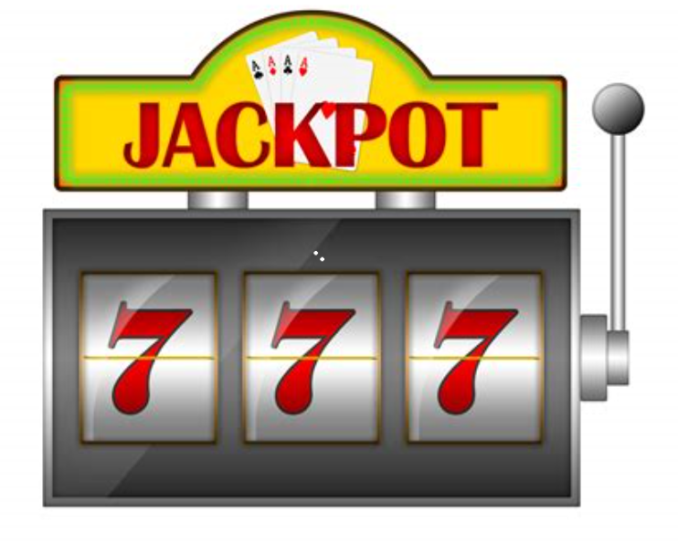
Start
Greeting/Rules
Starting Balance
Wager Choice: $1, $5
Bet Choices:
Bet X 1
Bet X 2
Bet X 3
Functions needed
3 Reels with random spin each
6 Values (7, BAR, Cherry, Diamond, Lemon, Bell)
Note: determine number of probabilities for each value. EX. 3 BARS should pay less than 3 cherries therefore cherries should not come up as frequent as BAR- John, tag you’re it!
Pull Lever
Spin Results
Payouts
End

